Slide 1
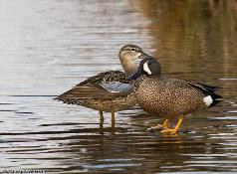
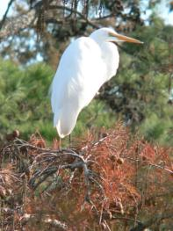
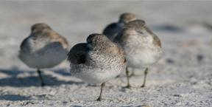
Integrated Waterbird Management & Monitoring (IWMM)
Documentation for IWMM Online Database – Part 2:
IWMM Download & Reporting Features

Slide 2
Topics
Review of IWMM Database and Definitions
Downloads
Projects can download their available project data at any time
Some legacy data not available for downloads
Data cleared to level 5 publicly available for download
Reporting
Basic reporting on all data types with the exception of some legacy data
Can export/download for incorporation into reports
Data cleared to level 2 and higher summarized in reports

Slide 3
Review of IWMM Database
Online database, built by Point Blue Conservation Science
A node of the Avian Knowledge Network
Projects and users must register
Data sharing governed by levels selected by Project Leaders
Data entry
Bird survey data – counts and site conditions
Vegetation data – annual rapid assessment data
Management Actions – plans & reporting on habitat management actions
Reporting
Basic reporting on all data types
Can export/download for incorporation into reports
Data Downloads
Projects can download and export their data at any time

Slide 4
A note on login and user interface issues
Users have reported the following issues:
From the dashboard, after navigating to a Project and selecting features such as Data Entry / Bird Survey, or Projects / Manage Units, etc., you are prompted to login again.
After navigating to the page you want to go to, you are not able to see recent updates or fixes, or complete certain tasks.
These login issues may be a result of the FWS Chrome browser having a strong persistent cache and accessing an un-secure website pathway.
First, make sure the URL you use begins with https. Then, please try clearing your cache if you experience login or user interface issues before submitting a help ticket.

Slide 5
Review of Definitions
Project – a collection of survey units that are administered as a single unit (e.g., a single NWR)
Survey Unit – a single management unit where sampling will occur
Sharing Level – defined by AKN - http://www.avianknowledge.net then go to Data, Data Access
Note IWMM Data Sharing Policy differs slightly from AKN policy
Legacy Data – data collected prior to July 2015 with earlier version of protocol. May include some site conditions.
Current protocol – protocol version released for use July 2015. Includes ALL site conditions.

Slide 6
Downloads

Slide 7
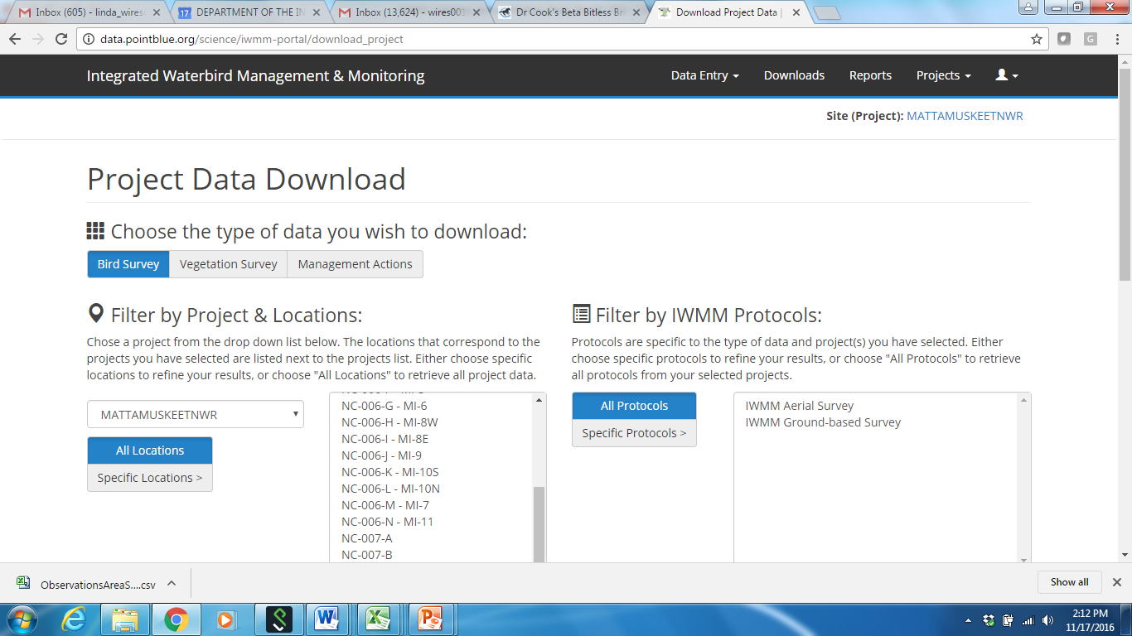
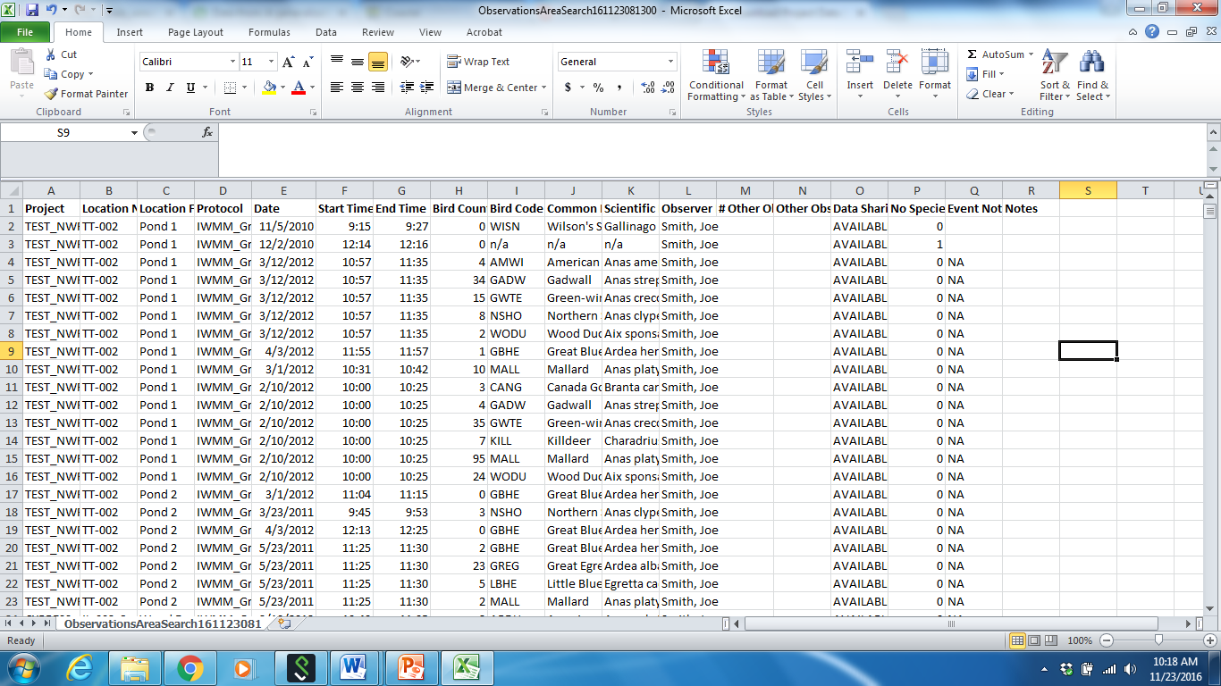
Data can be downloaded for Bird Surveys, Vegetation Surveys and Management Actions as an Excel compatible data sheet (CSV)

Slide 8
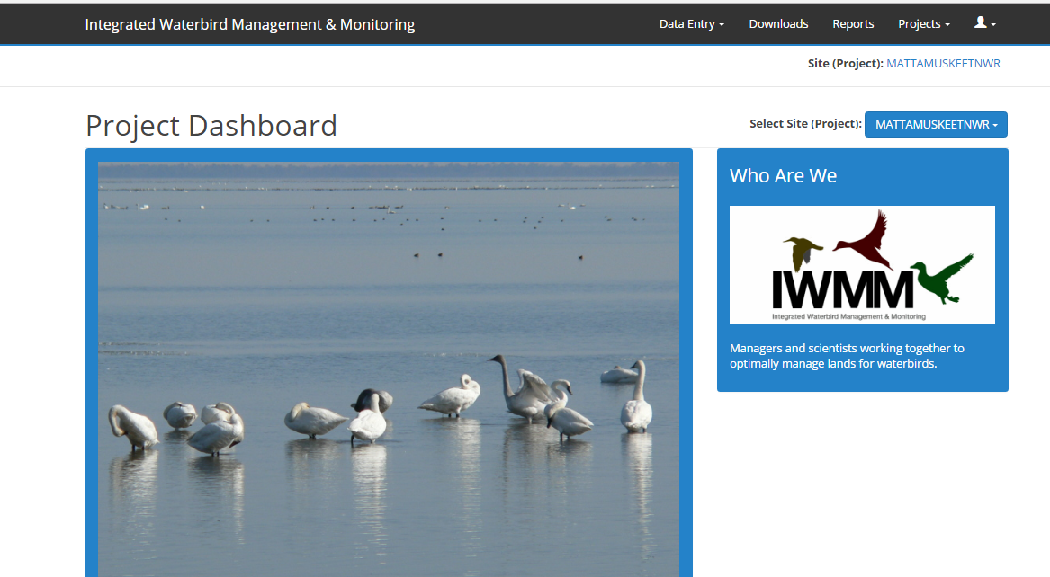
2
1
Users must be associated with a project (e.g., Project Leader or Researcher status) in order to download project data
From Project Dashboard, select project from dropdown list for which you wish to download data
From menu tabs (black bar) click “Downloads”

Slide 9
Downloading Data: specifying criteria

Slide 10
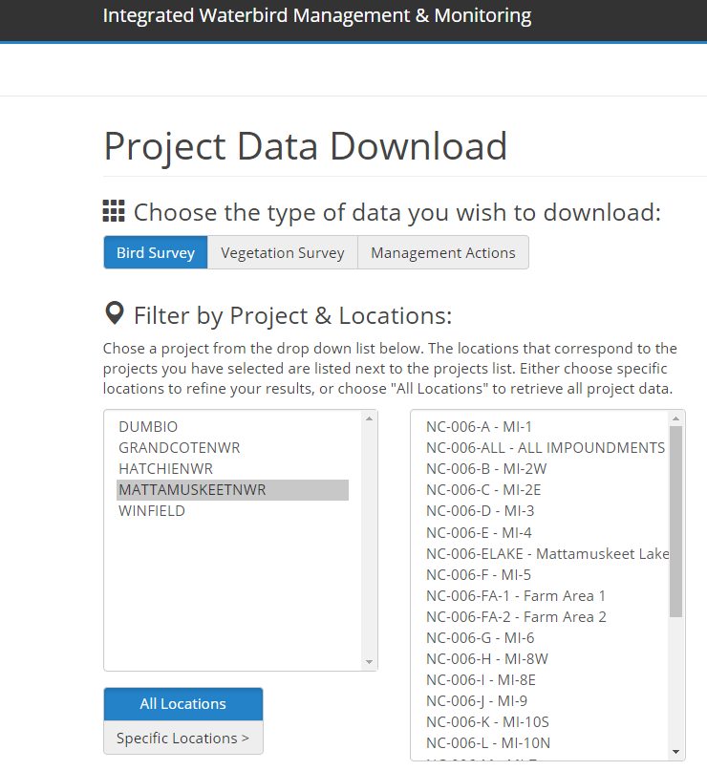
All Data Types – can filter by Project & Location (Unit):
Project List
Unit List
Select Project from dropdown list: “MATTAMUSKEETNWR”
Can change project selected here at any time
If you are Project Leader for more than one project, you can select more than one project at a time
To download data for all associated project locations (units), click “All Locations”
For specific units, select one or more units from unit dropdown list

Slide 11
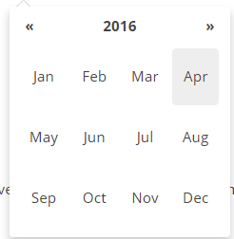
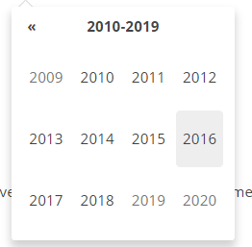
All Data Types – can filter by Date
2
1
3
Choose “All Dates” to download all observations
Choose “Date Range” and select from calendar to download observations collected over specific time
Click on the month (e.g. November 2016) to display additional months and years

Slide 12
Bird Survey Data –
can also filter by Protocol:
Choose “All Protocols” for data collected under all protocols
Choose “Specific Protocols” and select from dropdown list for data collected under specific protocol(s)
Notes:
You will not be able to download area search and/or waterbird data that is NOT IWMM from this portal.
For help downloading data that is not IWMM, contact the IWMM Project Coordinator.

Slide 13
Bird Survey Data –
can also filter by Species Observed:
For all species, select “All Species”
For > 1 specific species, select species from drop down list

Slide 14
Bird Survey Data –
can also filter by Species Observed / Guilds
Guild
Dropdown list for guild
For a specific guild, select “Specific Guilds”
Within the guild you can also filter by 1 or more species by selecting from the dropdown list for the guild selected.

Slide 15
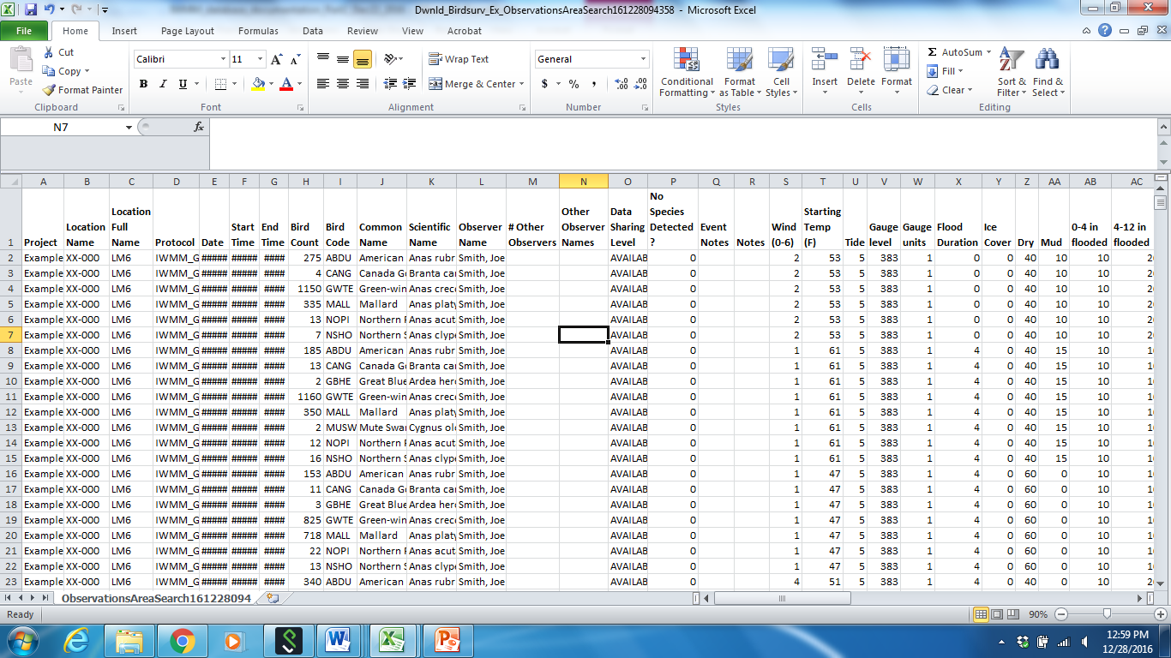
Bird Survey Download
Contains bird survey and unit condition data for terms specified
Includes both legacy data and data collected under current protocol

Slide 16
Bird Survey Download: Unit Conditions data
Because unit conditions protocol were revised in 2015, data collected under historical and current protocols are displayed separately
Data via historical site conditions protocol: columns S – AG.
Data via current site conditions protocol: columns AH – BO.

Slide 17
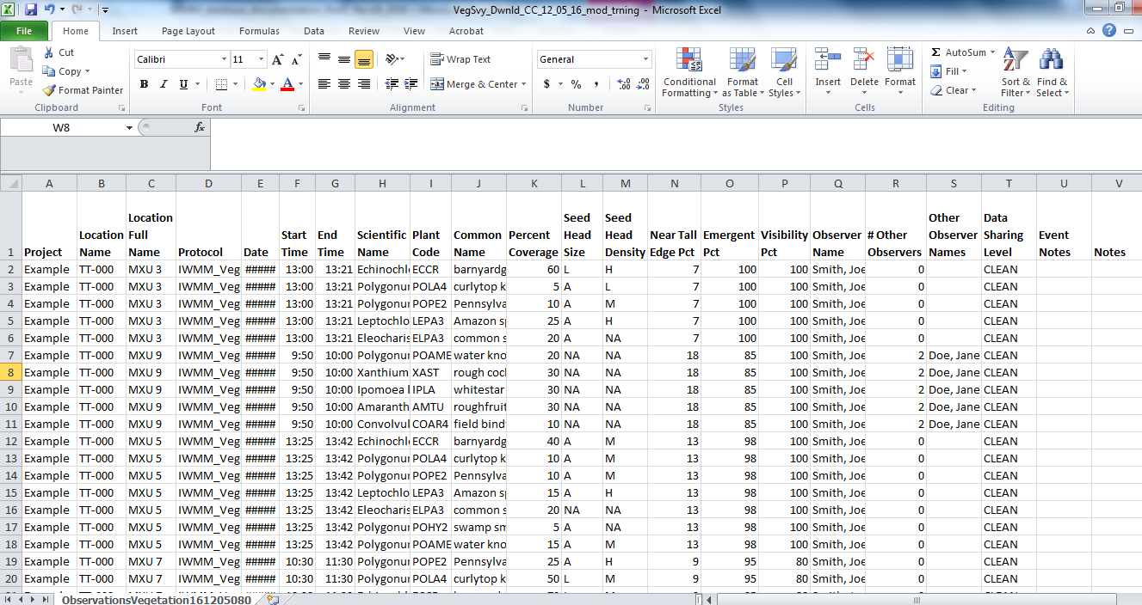
Vegetation Survey Download
Contains vegetation survey data for terms specified
Downloads do not include legacy data due to significant changes in habitat protocol.
For access to legacy vegetation data contact IWMM Staff

Slide 18
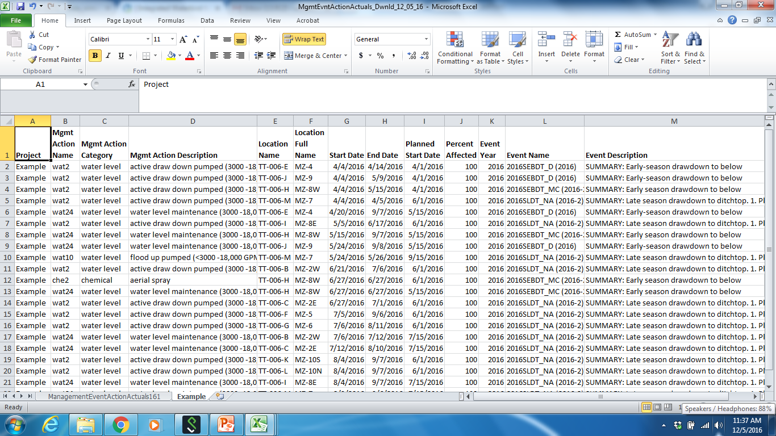
Management Actions Download
Contains management actions data for terms specified
Contains description of management actions employed
Tracks percent of unit affected over treated time period.

Slide 19
Reports

Slide 20
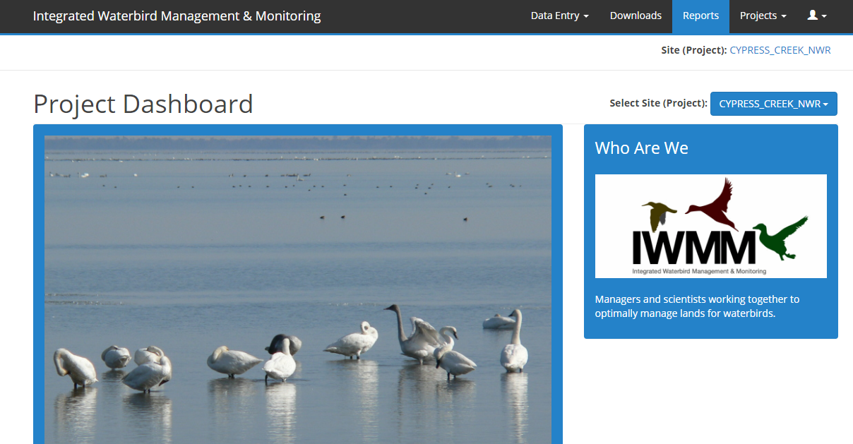
From Project Dashboard, click “Reports”
Note: Data cleared to appropriate status are available for inclusion in reports the day after they are entered, after 12 noon Pacific Time
Notes:
Appropriate status to allow for data to appear in reports is Level 2, however, it is encouraged that all data be promoted to Level 5.
Sharing status level descriptions can be viewed at http://www.avianknowledge.net/index.php?page=data-access.

Slide 21
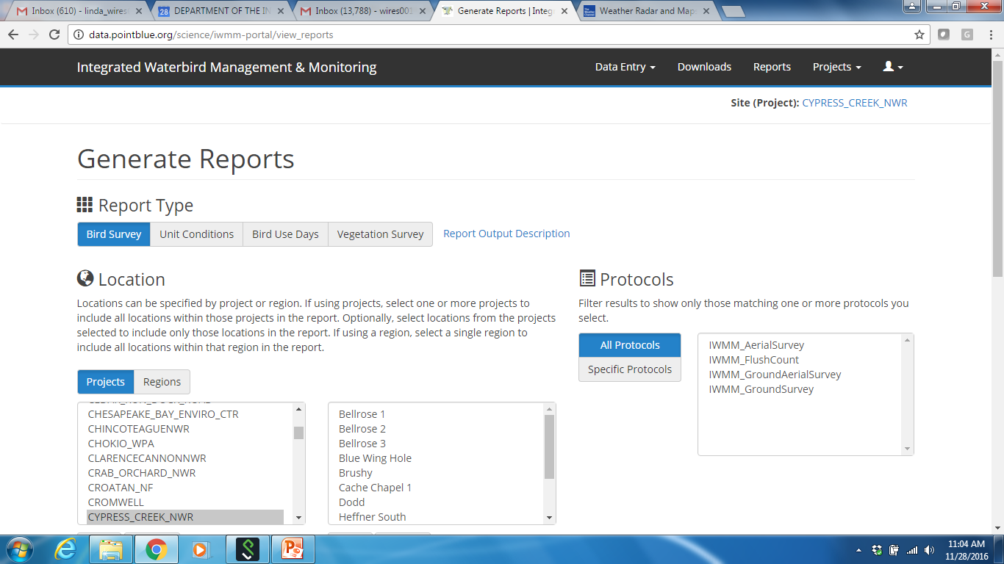
Reports Types include:
Bird Survey: Summary of visits, # of total birds, # taxa, # of individuals by species, etc.
Unit Conditions: Min, max, median, mean, s.d. of 5 parameters
Bird Use Days: Estimates total number of birds to use a unit over a specified time period (2 methods of estimation)
Vegetation Survey: Plant taxa identified, Seed Production Index, percent cover, etc.

Slide 22
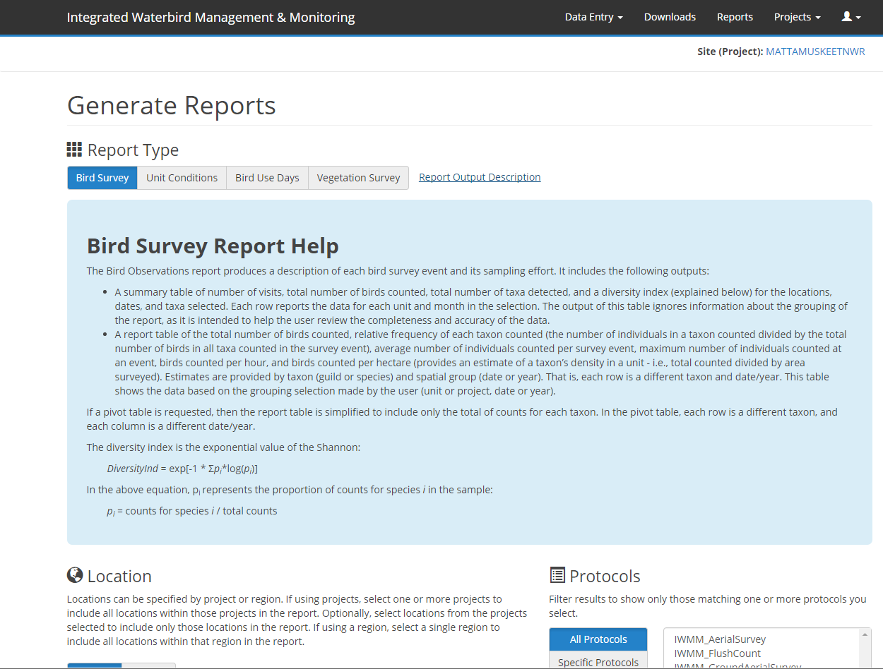
Understanding & Interpreting Reports
For a detailed description of each report type, output and values generated, select Report Type & click Report Output Description.

Slide 23
Bird Survey Report

Slide 24
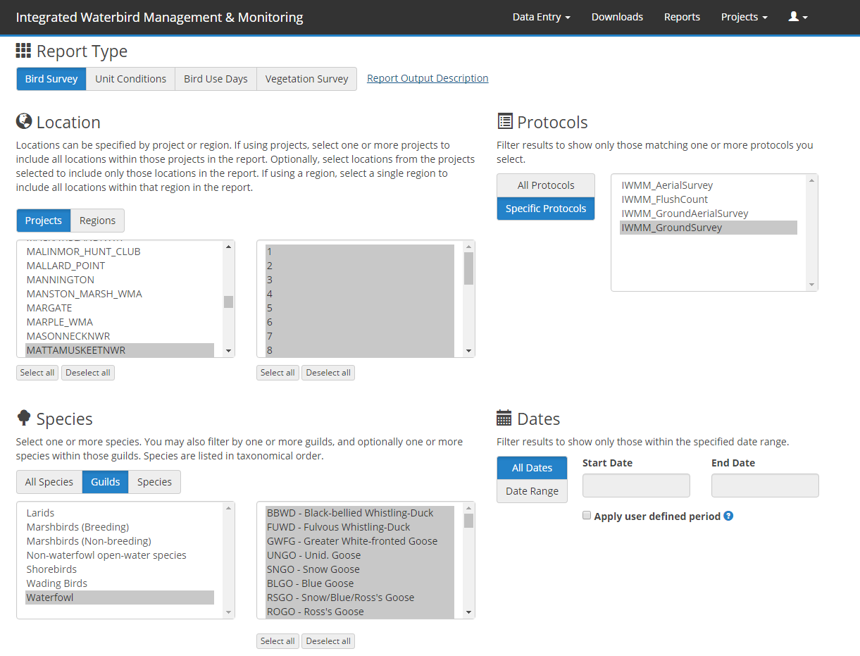
Generating a Bird Survey Report: Specify Criteria
As in Downloads, reports can be generated by filtering Location, Protocol, Species, and Dates.

Slide 25
Bird Survey Report: Specify Grouping Options
Specify how results are grouped based on selection of units or projects with date or year.
Pivot Table: Select to simplify table to include only the total of counts for each taxon.

Slide 26
Bird Survey Report: Data and Format Availability
Incorporates:
Legacy data
Data collected under current protocol
Formats:
Interactive viewing
Downloads
CSV file
PDF file

Slide 27
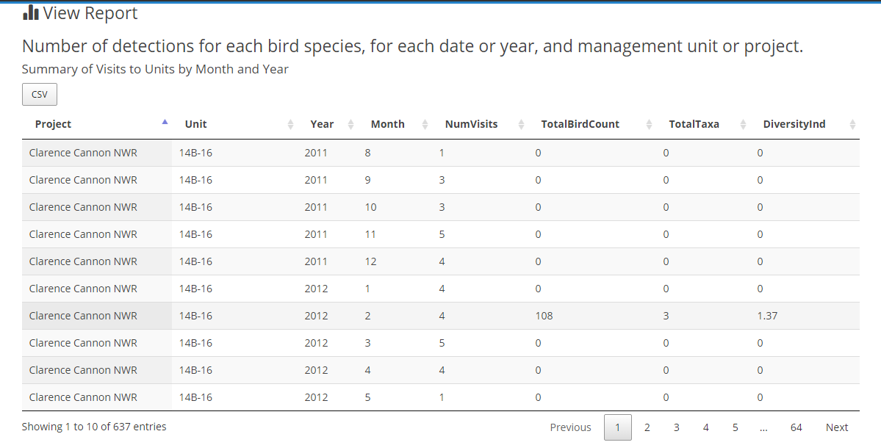
Example Bird Survey Report: Tables
Summary of visits info: number of visits, total number of birds counted, total number of taxa observed, and a diversity index

Slide 28
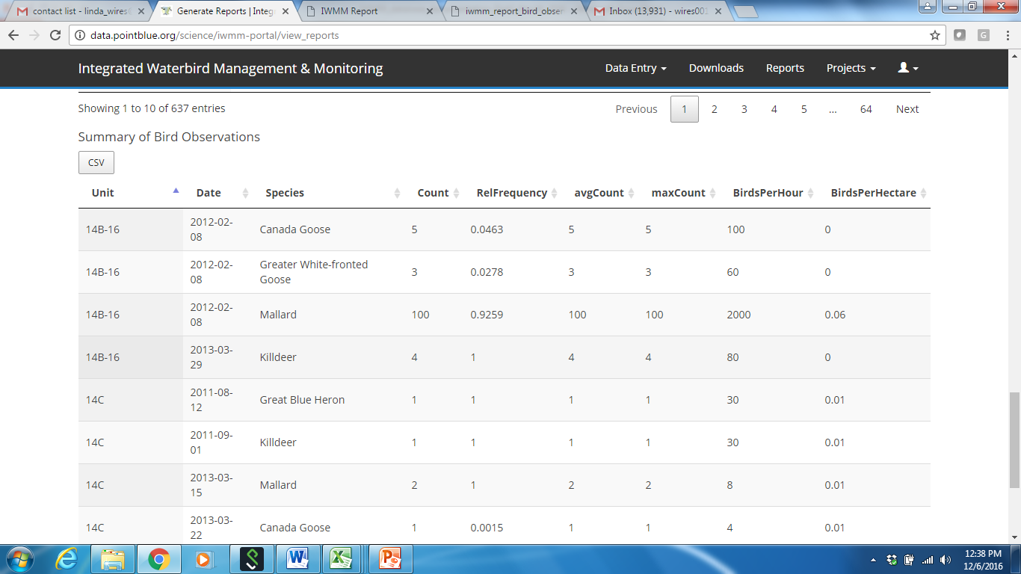
Example Bird Survey Report: Tables
Summary of bird observations: total for each species counted, relative frequency, average and max counts, birds counted per hour and per hectare.

Slide 29
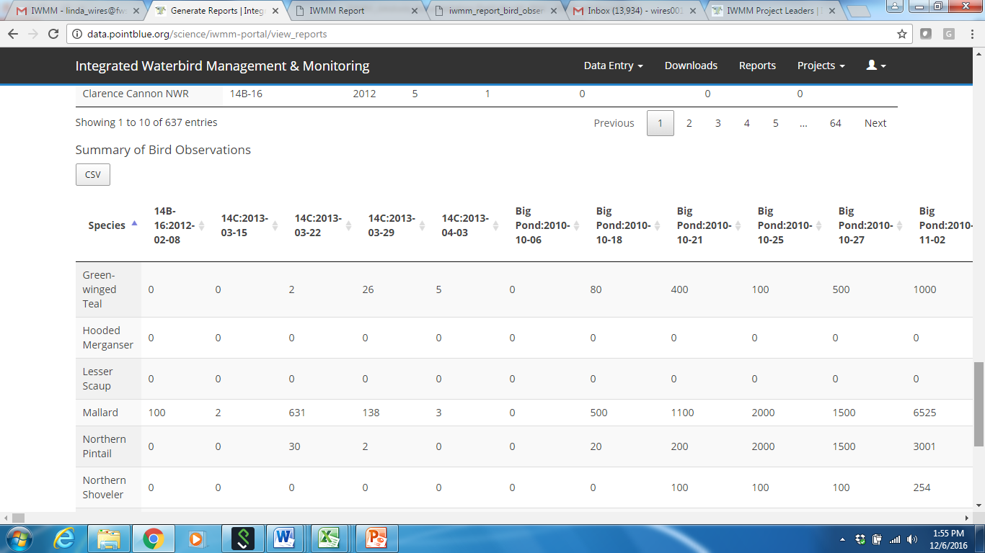
Example Bird Survey Report: Tables
Pivot table for bird observations: Simplified report table with the total of counts for each taxon. Each column is for each unit by each survey date/year. Example report filtered by guild.

Slide 30
Unit Condition Report

Slide 31
Generating a Unit Conditions Report: Specify Criteria
Can filter by Location and Date

Slide 32
Unit Conditions Report: Data and Format Availability
Incorporates:
Data collected under current protocol
Formats:
Interactive viewing
Downloads
CSV file
PDF file

Slide 33
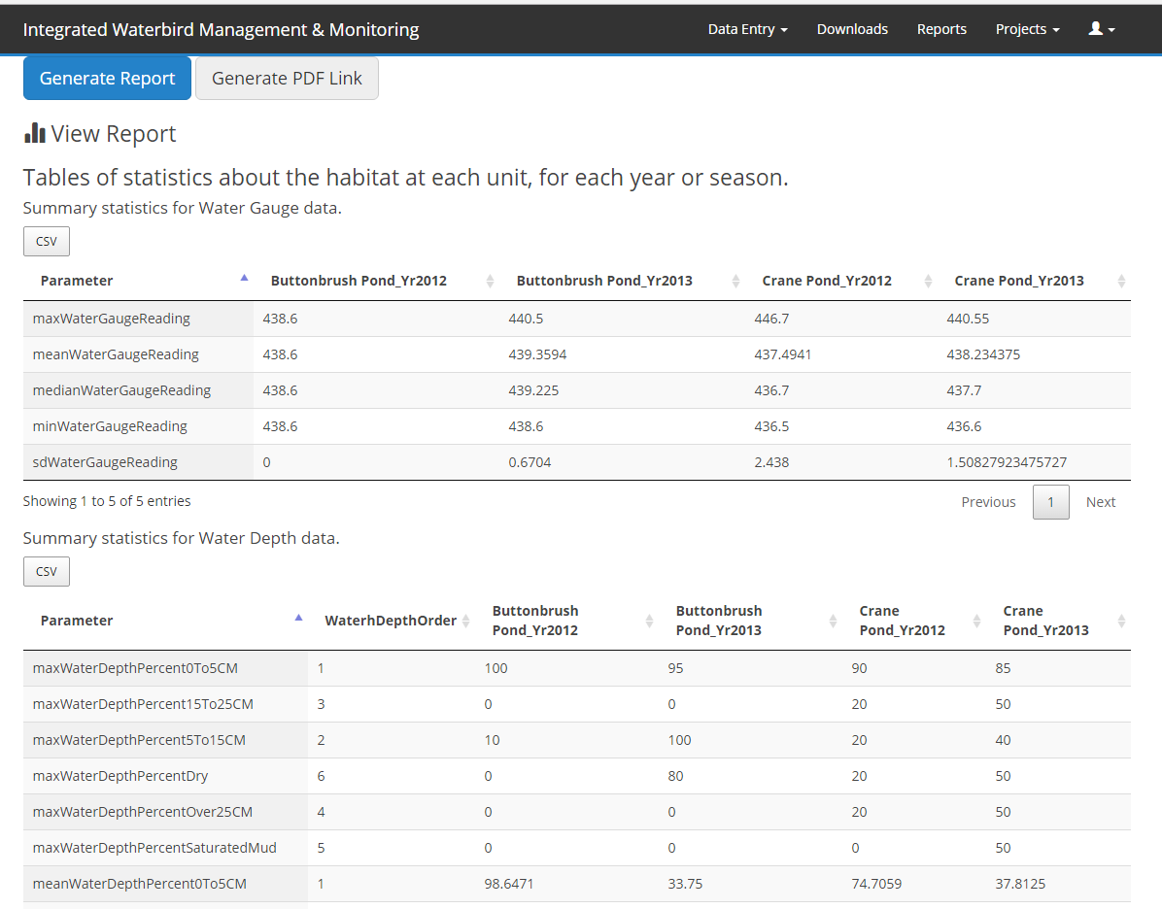
Example Unit Conditions Report: Tables
Summary Statistics: Always generated for each unit separately
Separate table for each of 5 possible parameters: salinity, water level, water depth, land cover, vegetation height

Slide 34
Bird Use Days Report

Slide 35
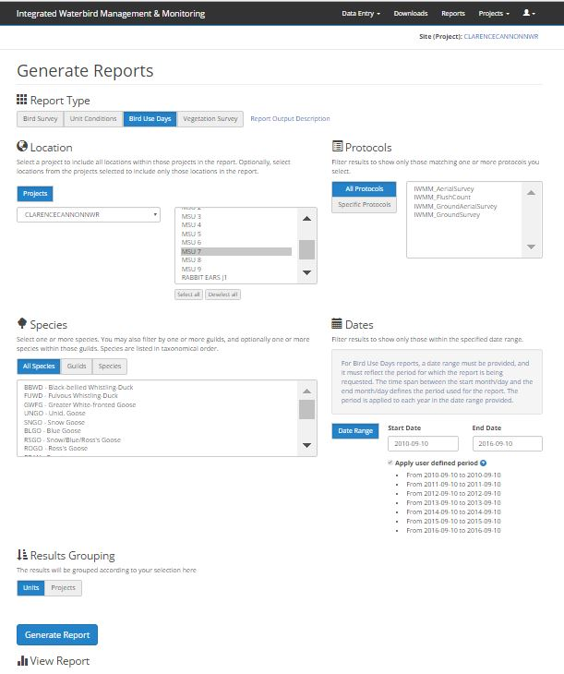
Generating a Bird Use Days Report: Specify criteria
Can filter by Location, Protocol and Species
Requires date range for period for which report is requested
The user-defined period is based on start month/day and end month/day and applied to each year in the date range specified

Slide 36
Bird Use Days Report: Specify Grouping Options
Specify how results are grouped based on selection of units or projects, and also guilds.
Bird use days reports grouped by Project includes use-days summed across all units and then adjusted by the sum of all unit acres.
Bird use days reports grouped by Guilds will provide use-days summed across all species in selected guild at either level selected (unit or project).

Slide 37
Bird Use Days Report: Data and Format Availability
Incorporates:
Legacy data
Data collected under current protocol
Formats:
Interactive viewing
CSV file
PDF file

Slide 38
Example Bird-Use-Days Report: Tables
Bird-Use Days estimates per species & unit:
adjusted for area (per hectare)
unadjusted for area (total use-days for unit)

Slide 39
Example Bird-Use-Days Report: Tables
Bird-Use Days estimates grouped by Project and Guild

Slide 40
Example Bird-Use-Days Report: Migration Curve
Can be generated for each taxon selected, for a maximum of 5.
For a report for more than 5 species, the first 5 in taxonomic order with data to plot will be plotted.
To plot more than 5 species, select in groups of < 5, and generate plots one at a time.

Slide 41
Example Bird-Use-Days Report: Migration Curve
Two migration curves generated:
Adjusted for area (birds per hectare)
Unadjusted for area (total birds per unit)

Slide 42
Example Bird-Use-Days Report: Migration Curve
Click on species in legend to remove or add back into graph

Slide 43
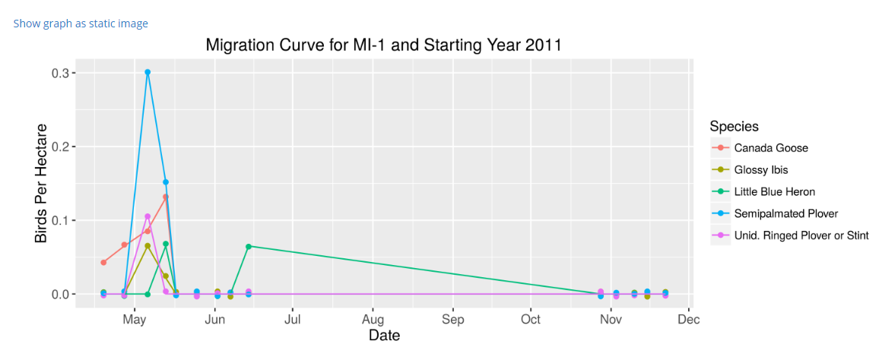
Example Bird-Use-Days Report: Migration Curve
Click on “Show graph as a static image” to produce graph with formatting for inclusion in reports.
Static image can be saved as PNG by right clicking on image and selecting “save image as”.

Slide 44
Vegetation Survey Report

Slide 45
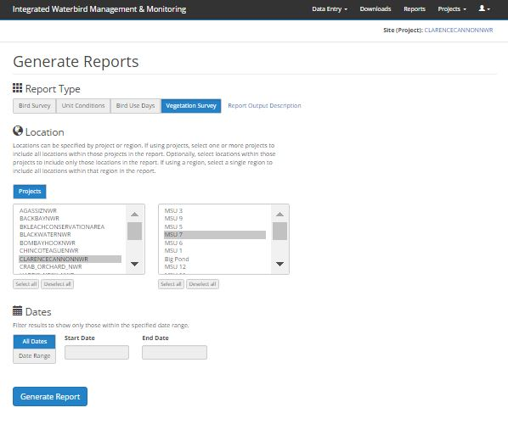
Generating a Vegetation Survey Report: Specify criteria
Can filter by Location and Date

Slide 46
Unit Conditions Report: Data and Format Availability
Incorporates:
Data collected under current protocol only
Legacy data not available
Formats:
Interactive viewing
Downloads
CSV file
PDF file

Slide 47
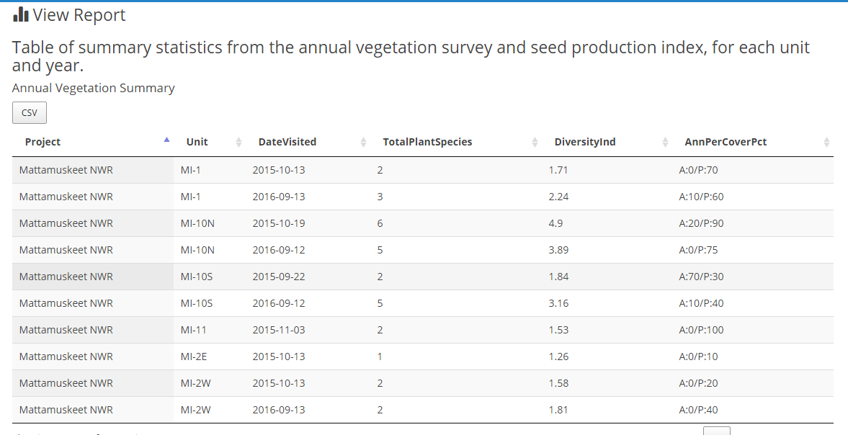
Example Vegetation Survey Report: Tables
Annual Vegetation Summary: reports total plant taxa identified, diversity index, and percent cover of all taxa identified as annual and perennial plants.
The total, annual, and perennial plant cover can exceed 100%, as the cover of individual plants can overlap extensively.

Slide 48
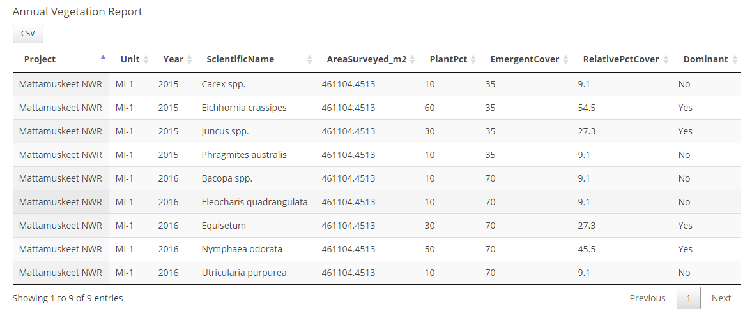
Example Vegetation Survey Report: Tables
Annual Vegetation Report: For each unit and year, includes for each plant species observed: survey unit area, proportion of vegetated portion of the unit covered by the species (Plant Pct), percent of unit that is emergent vegetation , relative percent cover, and dominance status.

Slide 49
Example Vegetation Survey Report: Tables
Seed Production Index Report: Includes a seed production index (SPI) for each year and tracks temporal changes in seed production within units.
Calculated for:
plant species consumed by waterfowl where the plant percent vegetative cover is > 5%
only those plant foods for which seed head size and density were estimated using measurements provided in the IWMM Photographic Seed Head Assessment Guide.
An SPI = 0 indicates that none of the SPI plant species were present or that they were not measured.

Slide 50
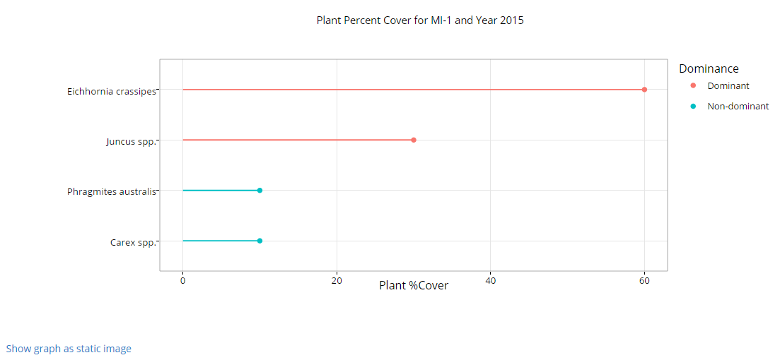
Example Vegetation Survey Report: Dominance Graphic
Plant Dominance Status: Estimated by applying the 50/20 rule
(those species that represent the first 50% of the total plant area, plus those species that cover an area > 20%).
Click on species in legend to remove or add back into graph
Click on “show image as static graph” for PNG image to include in report.

Slide 51
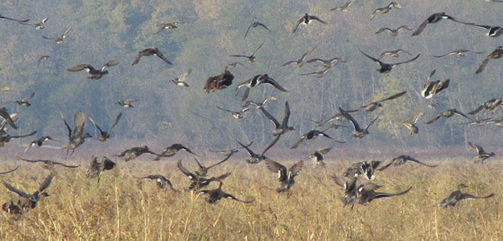
For Additional Help Contact:
Rob Fenwick
IWMM Coordinator robert_fenwick@fws.gov
Tim Jones
IWMM Database Lead
tim_jones@fws.gov

